Slide 1
Don’t be a faceless researcher: The importance of controlling your online presence.
Jack Rivers-Auty
BBSRC Discovery research fellow
University of Manchester

Slide 2
Road rage and academia: being more than a first author in a Toyota.
Jack Rivers-Auty
BBSRC Discovery research fellow
University of Manchester

Slide 3
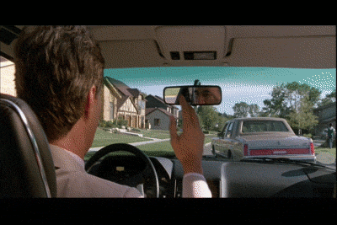
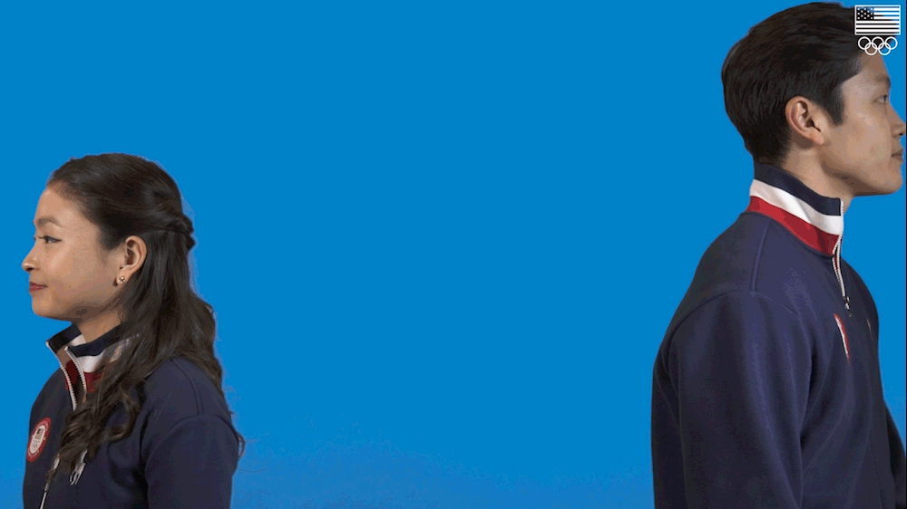

Slide 4
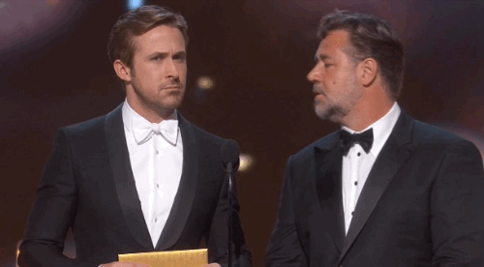

Slide 5
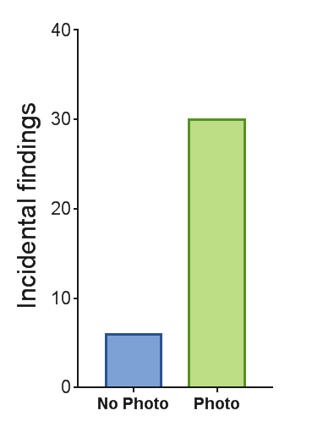
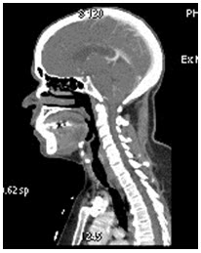
Actual research
The radiologist were more meticulous in reviewing the scans when the photo was included.
When ask why they reported greater feelings of empathy
50%
318 CT scans and patients medical records
50%
15 radiologist

Slide 6
Anonymity
If we know nothing about the person, we tend to have less empathy and attribute more negative attributes

Slide 7
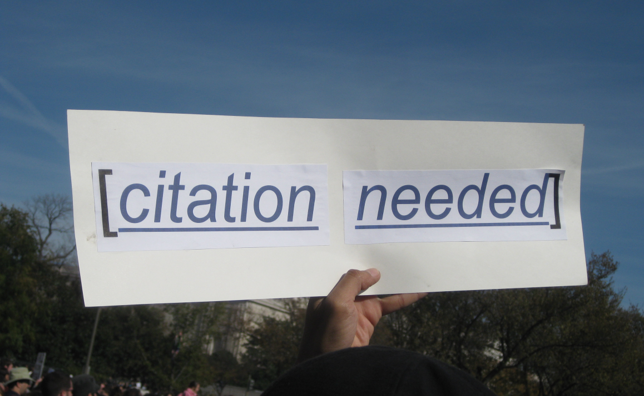
Road rage and academia: being more than a first author in a Toyota.

Slide 8
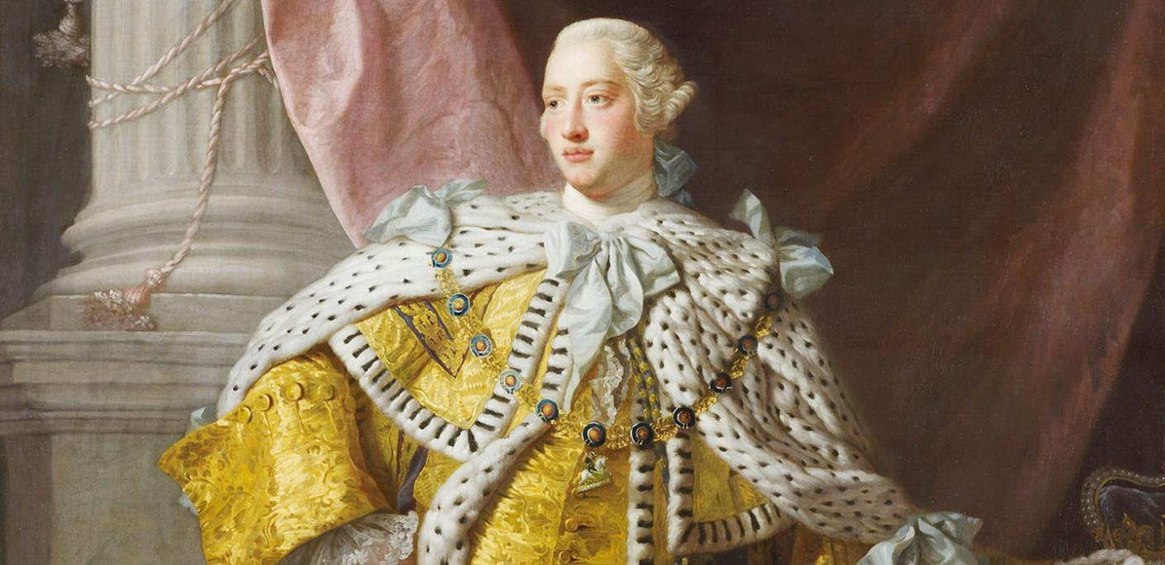
This might be a bit tough for you Brits
Well I suppose I helped colonise a few countries, but it was mostly Capt. James Cook really.

Slide 9
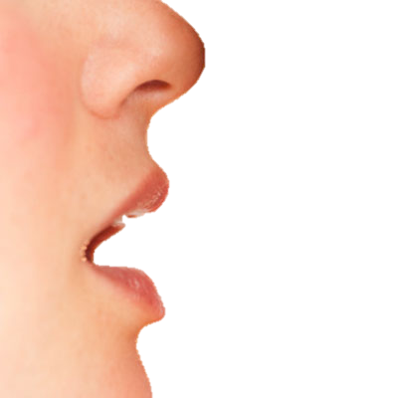
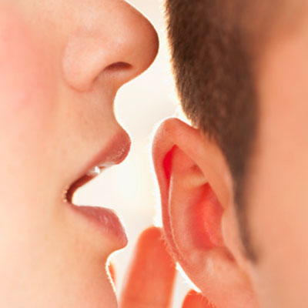
Sneaky pro-tip for get known
Nature
^
Publish papers

Slide 10
Online research profiles

Slide 11
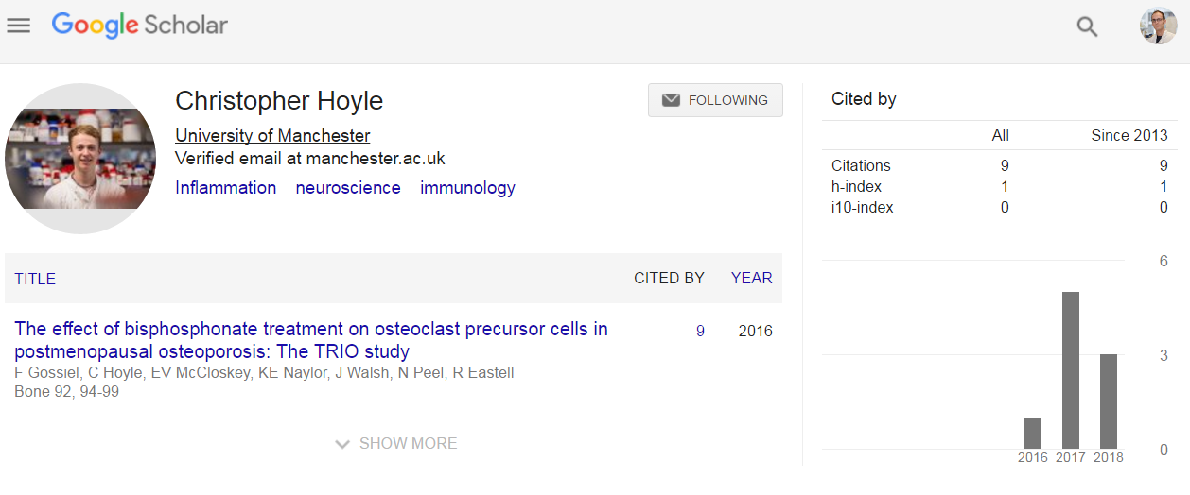

Slide 12
The LinkIn for scientists – It’s important just ask this guy

Slide 13
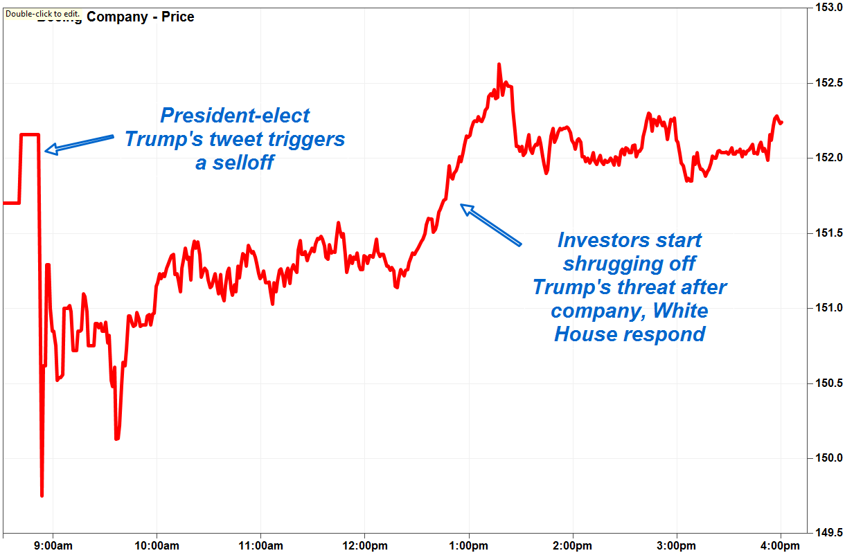

Slide 14
The LinkIn for scientists
The means that for every 14.28 tweets you get for your paper you’ll get an extra citation
For every increase in your journal impact factor of 5.88 you’ll get an extra citation
Peoples BK, Midway SR, Sackett D, Lynch A, Cooney PB (2016). PLOS ONE 11(11): e0166570

Slide 15
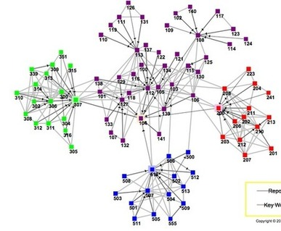
The LinkIn for scientists
Exponential relationship with follows.
Win Win.
Everyone at the break trade follows with 10 people

Slide 16
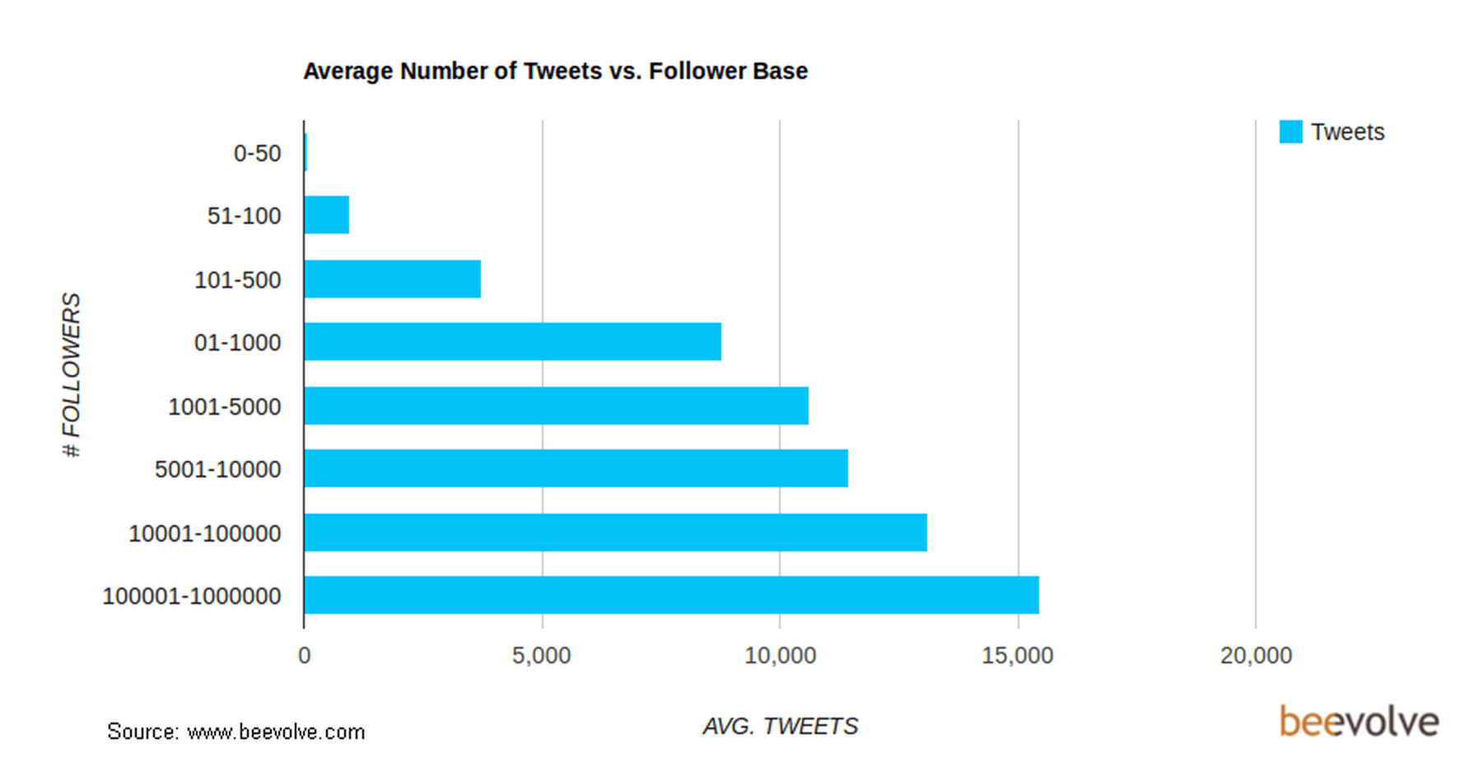
The LinkIn for scientists
Conclusion:
Tweet

Slide 18
https://www.youtube.com/watch?v=l4kBcbdzwDM

Slide 19
News
Contact your local media relations team.
Do it well before you publish a paper because they’ll want to have a press release prepared
Be responsible in your press release.

Slide 20
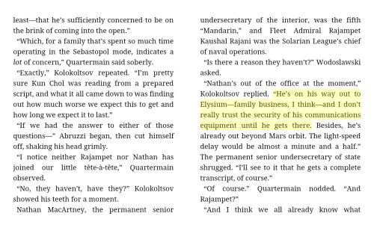
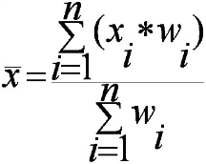
2 years
Write Wikipedia articles on science subjects which currently do not have wiki articles

Slide 21
CV website/Blog
https://mikejddaniels.com/sci-comms/

Slide 23
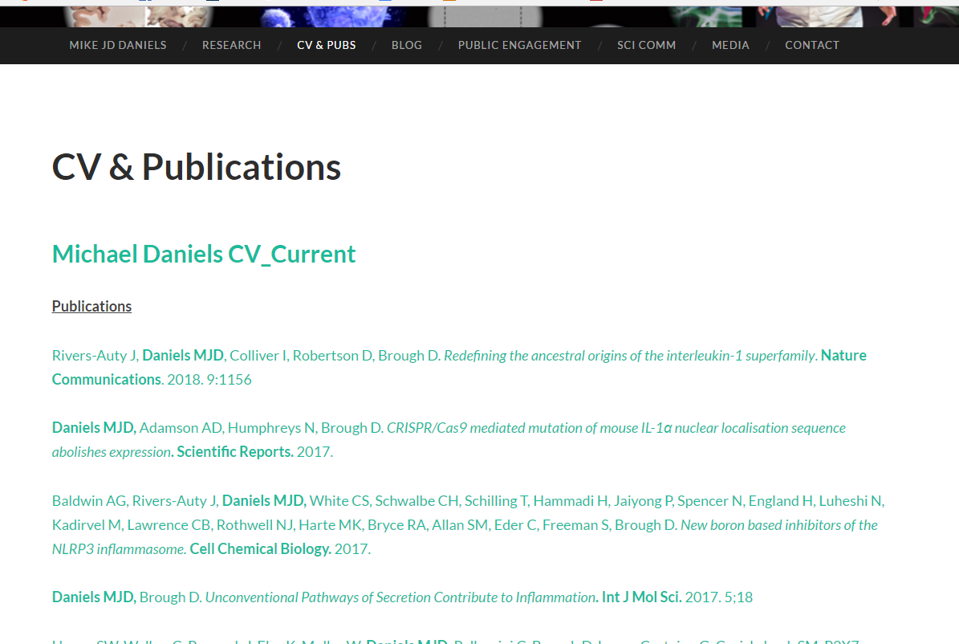
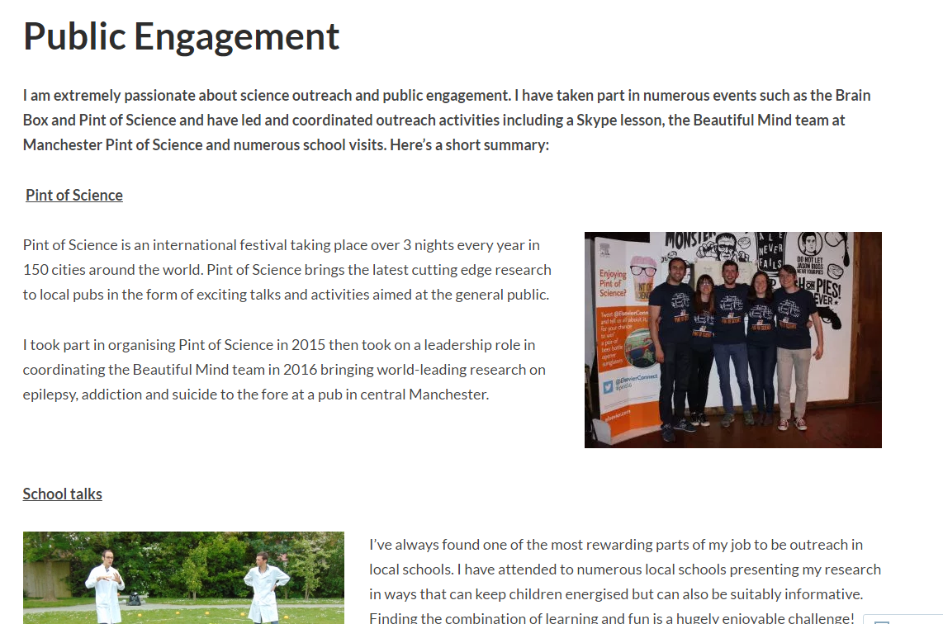
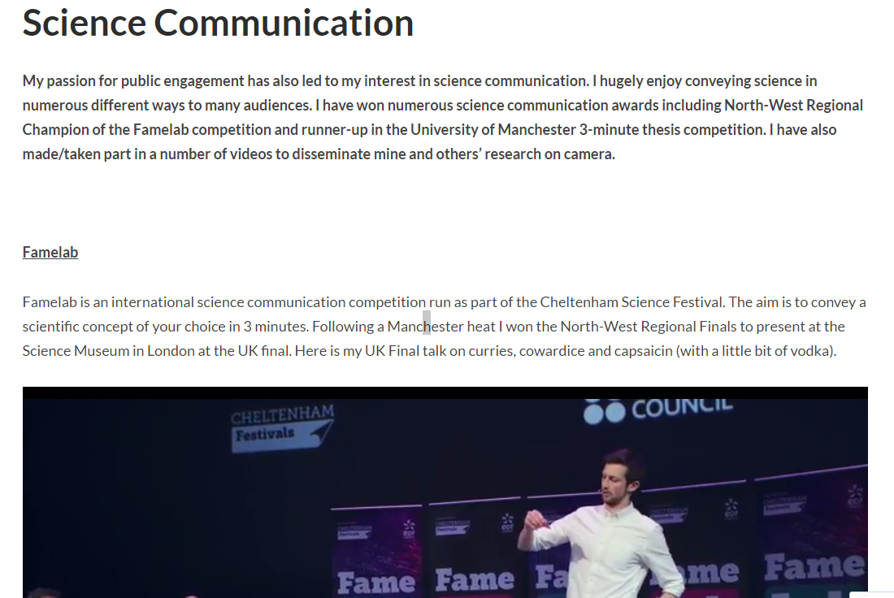
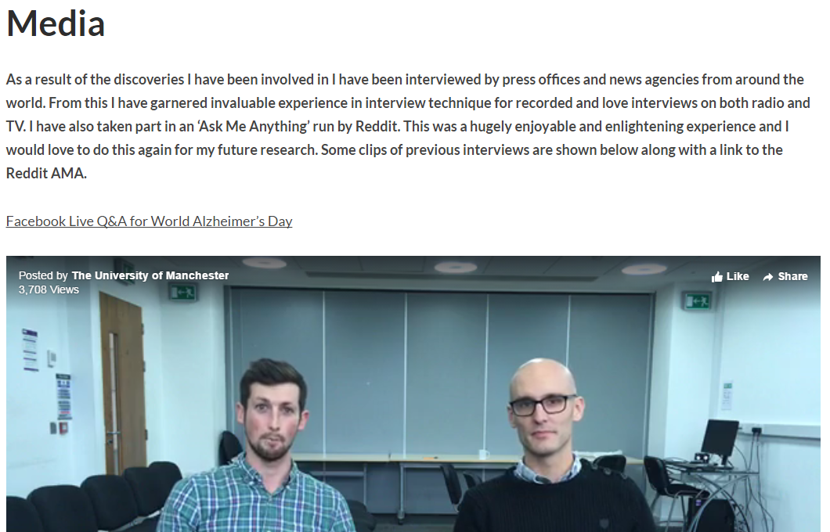

Slide 26
Altemetrics

Slide 27
How is the Altmetric score calculated

Slide 28
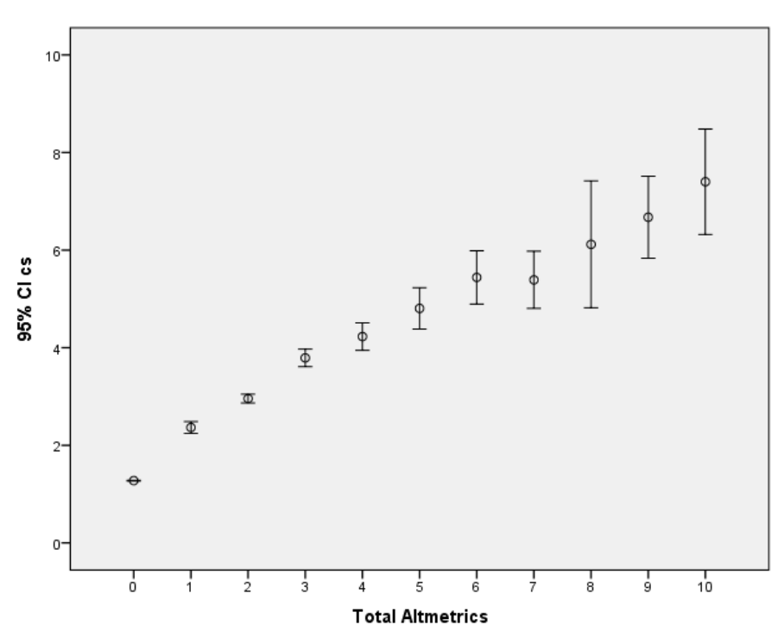

Slide 29
Email them about your website
info@altmetric.com

Slide 30
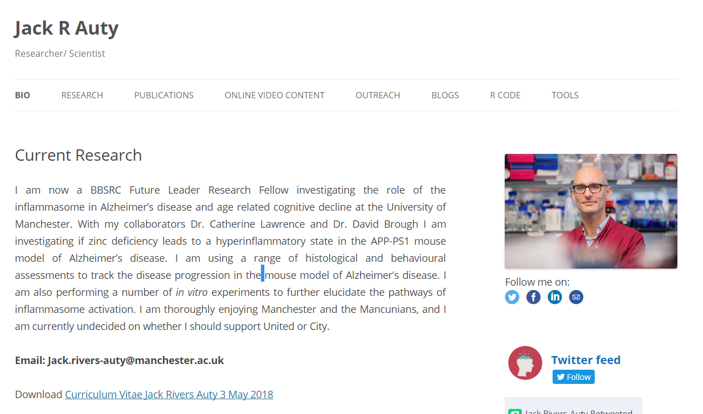
DAAAAAMMMMM Jacky boy, you’ve covered so much! I can’t remember all the thangs I gotsta do! Son!
JACKAUTY.COM
Right now!!!!!

